Slide 1
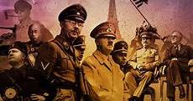
WORLD WAR II 1939-1945

Slide 2
Why did the war begin?
After World War One ended in 1918, Germany had to give up land and was banned from having armed forces.
In 1933 the German people voted for a leader named Adolf Hitler, who led a political party in Germany called the National Socialists or Nazis. Hitler promised to make his country great again and quickly began to arm Germany again and to seize land from other countries.
Shortly before 5am on Friday 1st September, 1939, German forces stormed the Polish frontier. Tanks and motorised troops raced into the country over ground, supported by Stuka dive bombers overhead. A total of 1.25 million Germans soldiers swept into Poland
World War Two in Europe began on 3rd September 1939, when the Prime Minister of Britain, Neville Chamberlain, declared war on Germany. It involved many of the world's countries.

Slide 3
Who were the leaders and countries?
Axis: Adolf Hitler (Germany), Benito Mussolini (Italy), and Emperor Hirohito (Japan).
Allies: Franklin Roosevelt (the United States), Winston Churchill (Great Britain), and Joseph Stalin (the Soviet Union).

Slide 4
What as the blitz
The heavy and frequent bombing attacks on London and other cities was known as the 'Blitz'. Night after night, from September 1940 until May 1941, German bombers attacked British cities, ports and industrial areas.
London was bombed ever day and night, bar one, for 11 weeks. One third of London was destroyed.

Slide 5
Keeping safe during the blitz
Children and some women were evacuated from the big cities into the countryside. People carried gas masks to protect themselves against a possible gas attack. People built air raid shelters in their gardens. All windows and doors were blacked out to make it harder for the enemy planes to spot where they lived.

Slide 6
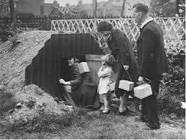
Shelters
These shelters were half buried in the ground with earth heaped on top to protect them from bomb blasts.
Anderson Shelter
© The Imperial War Museum
They were made from six corrugated iron sheets bolted together at the top, with steel plates at either end, and measured 6ft 6in by 4ft 6in (1.95m by 1.35m). The entrance was protected by a steel shield and an earthen blast wall.

Slide 7
EVACATION
Evacuation was voluntary, but the fear of bombing, the closure of many urban schools and the organised transportation of school groups helped persuade families to send their children away to live with strangers. The schoolchildren in this photograph assembled at Myrdle School in Stepney at 5am on 1 September 1939. The adults accompanying them are wearing arm

Slide 8
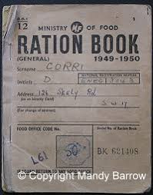
RATIONING
Rationing was a means of ensuring the fair distribution of food and commodities when they were scarce. It began after the start of WW2 with petrol and later included other goods such as butter, sugar and bacon. Eventually, most foods were covered by the rationing system with the exception of fruit and vegetables.

Slide 9
EVERYDAY LIFE DURING THE War
Rationing Everyone living on the home front in Britain during the war had to cope with shortages of food and clothing. Imported food could no longer reach Britain in such large quantities and food rationing was introduced in January 1940. ... From June 1941, clothing was also rationed.

Slide 10
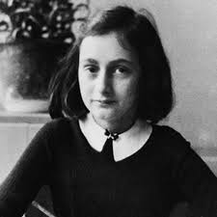
Anne Frank
Anne Frank was a teenage Jewish girl who kept a diary while her family was in hiding from the Nazis during World War II. For two years, she and seven others lived in a "Secret Annex" in Amsterdam before being discovered and sent to concentration camps. Anne died in the Bergen-Belsen camp in 1945.12 Jun 2017

Slide 11
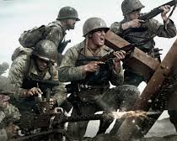
CHILDHOOD MEMORIES
My father, Alexander Forsberg, was born in 1912 in Freiberg, a small university town in the province of Saxony, about thirty kilometres southwest of Dresden. He was the youngest of twelve children, ten boys and two girls. My grandparents owned a large dance and concert hall on Schützenstrasse in Freiberg, called the Tivoli Forsberg. The largest room seated as many as twelve hundred persons. After the war, I remember my father telling me that before the National Socialists came to power this large room in the Tivoli was often used for political rallies. My grandparents insisted that the rally sponsors.
Notes:
hen the Russians come, our girl Lisbeth climbs into a box full of Hitler-pictures. All the glass panes shatter. My mother sits with us children in a sand pit at a playground because she thinks this way nothing is going to happen to her. When a soldier comes out of the basement I grab his trouser leg and shout: ‘You damned Russian, let my Lisbeth alone!’ He doesn’t do anything to me.
“In the villa opposite we hear a tremendous noise so my grandmother walks over resolutely. There the mother and daughter lie on the bed, naked, raped with their throats cut. My grandmother shouts at the drunken Russian until they leave. My mother, who’s a doctor, declares both women dead and buries them in the garden.”

Slide 12
EXPERIENCES OF LOCAL CHILREN
During World War Two 1.9 million people were evacuated from British cities where the risk of bombing was perceived to be highest. 1.5 million of these were children who, often unaccompanied, were sent to live with strangers. Two hundred and forty-five people who were evacuated as children were compared with 96 of similar age who did not experience evacuation. Within this self-selected sample, significant numbers of the evacuees were found to have experienced abuse and neglect. Pre-evacuation abuse made continued abuse likely during evacuation, while abuse during evacuation led to children being more likely to continue to be abused on their return home. Abuse during evacuation led to increased scores on the Impact of Event Scale and General Health Questionnaire, and to insecure attachment patterns. The role of evacuation and abuse in the maintenance of long-term psychological problems is discussed.

Slide 13
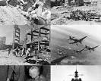
THE END OF WAR
World War 2 ended with the unconditional surrender of the Axis powers. On 8 May 1945, the Allies accepted Germany's surrender, about a week after Adolf Hitler had committed suicide. VE Day – Victory in Europe celebrates the end of the Second World War on 8 May 1945.

