Slide 1
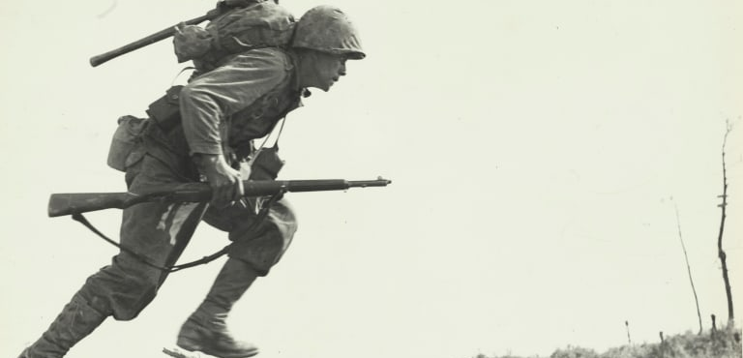
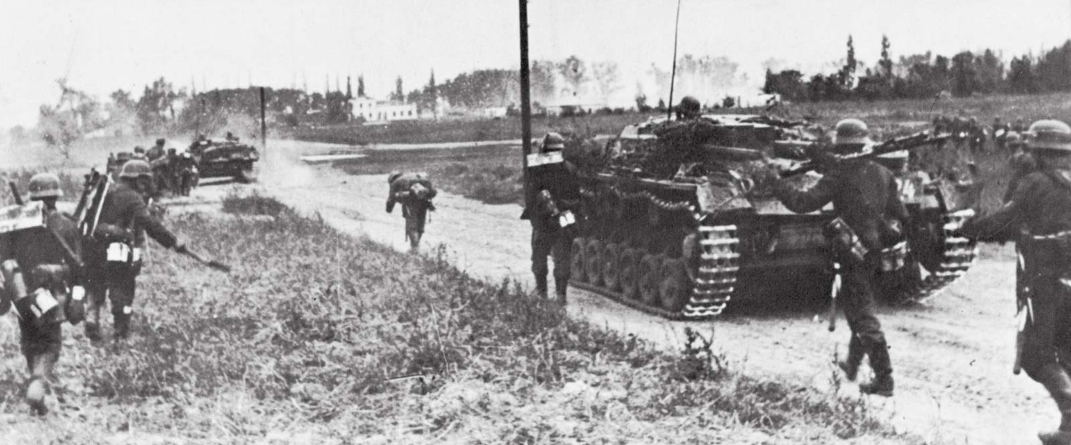
World War 2 1939-1945 by Molly Savage

Slide 2
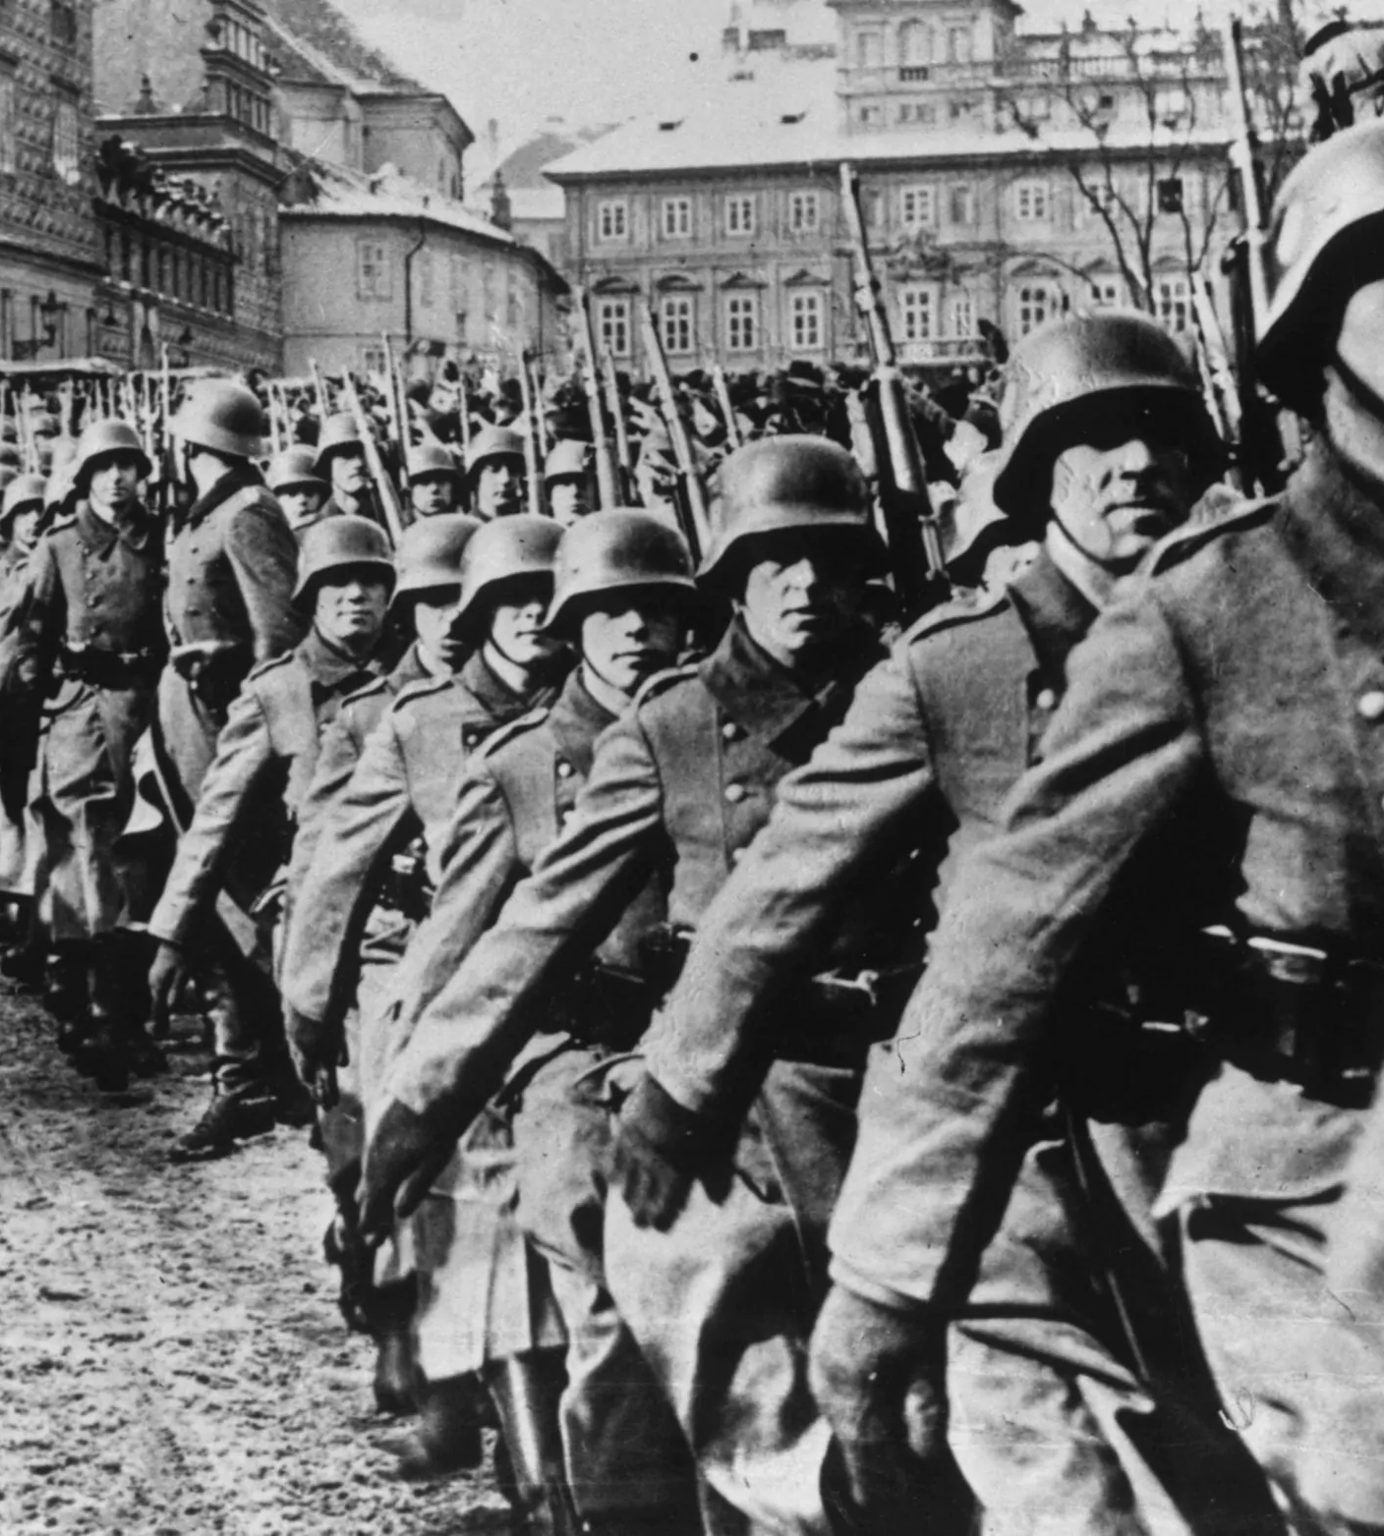
Why did it begin?
German anger over the Treaty of Versailles following WW1
The worldwide economic depression
Failure of appeasement
The rise of militarism in Germany and Japan
Failure of the League of Nations

Slide 3
Who were the countries involved?

Slide 4
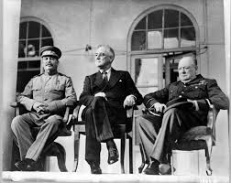
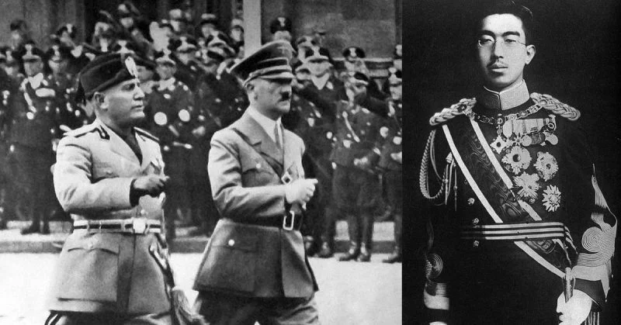
The leaders:
Stalin, Roosevelt, Churchill
V
Mussolini, Hitler, Hirohito

Slide 5
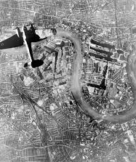
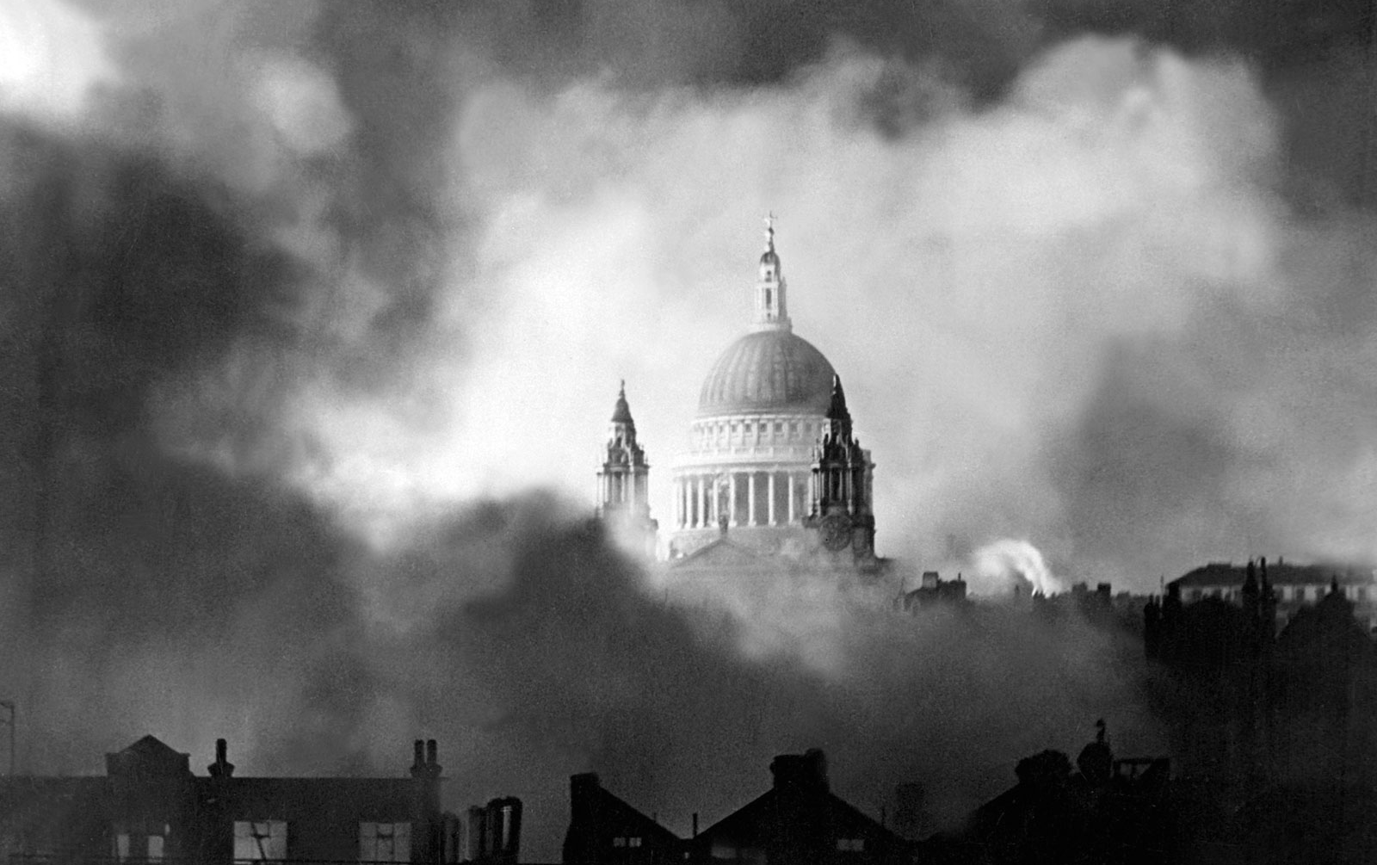
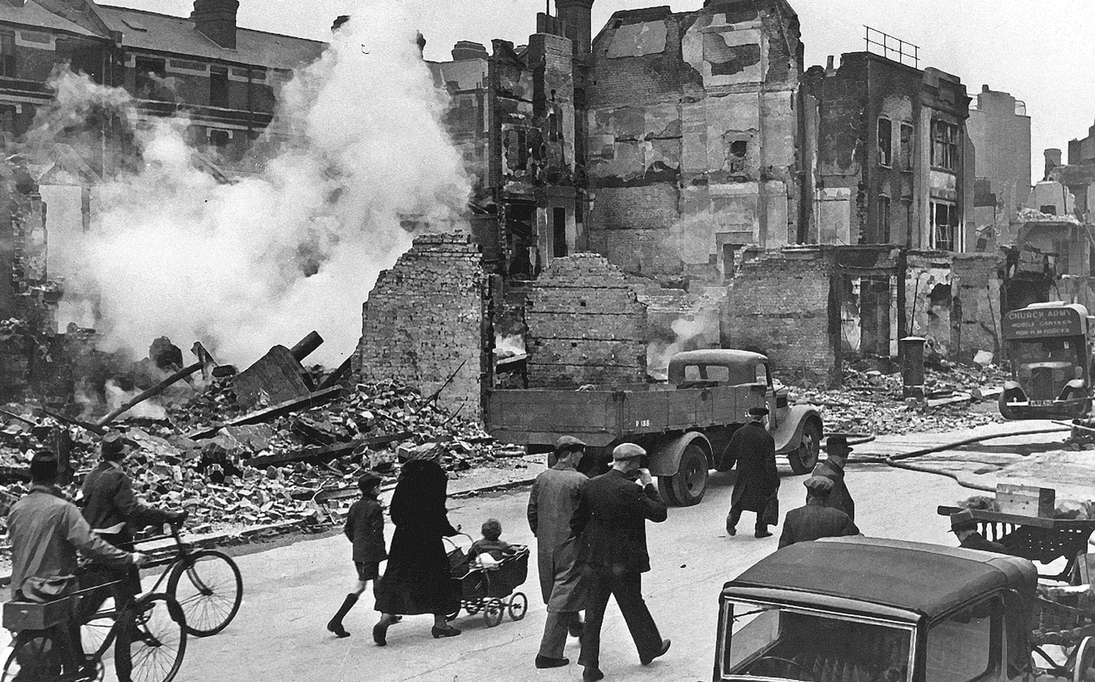
The Blitz
The Blitz was a German bombing campaign against the UK in 1940 and 1941, during the Second World War. The term was first used by the British press and is the German word for lightning.
About 32,000 were killed, 87,000 seriously injured and 2 million houses were destroyed.

Slide 6
Keeping safe during the Blitz
Children and some women were evacuated from the big cities into the countryside. People carried gas masks to protect themselves against a possible gas attack. People built air raid shelters in their gardens. All windows and doors were blacked out to make it harder for the enemy planes to spot where they lived.

Slide 7
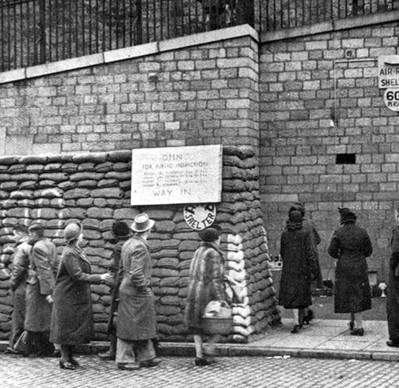
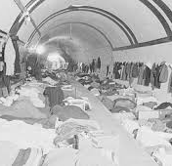
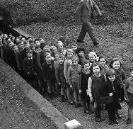
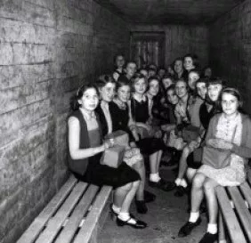
Air raid shelters

Slide 8
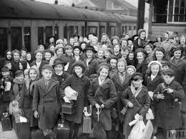
Evacuation
During the Second World War, many children living in big cities and towns were moved temporarily from their homes to places considered safer, usually out in the countryside.
The countryside had less population, they were dark, they didn’t have factories so the Germans didn’t bomb there.

Slide 9
Anderson Shelter

Slide 10
Morrison Shelter

Slide 11
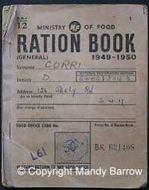
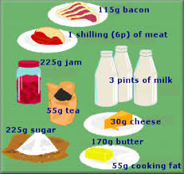
Rationing
The main items that were rationed during the war were meat, fuel, cheese, butter, margarine, canned or processed foods, tea and sugar.

Slide 12
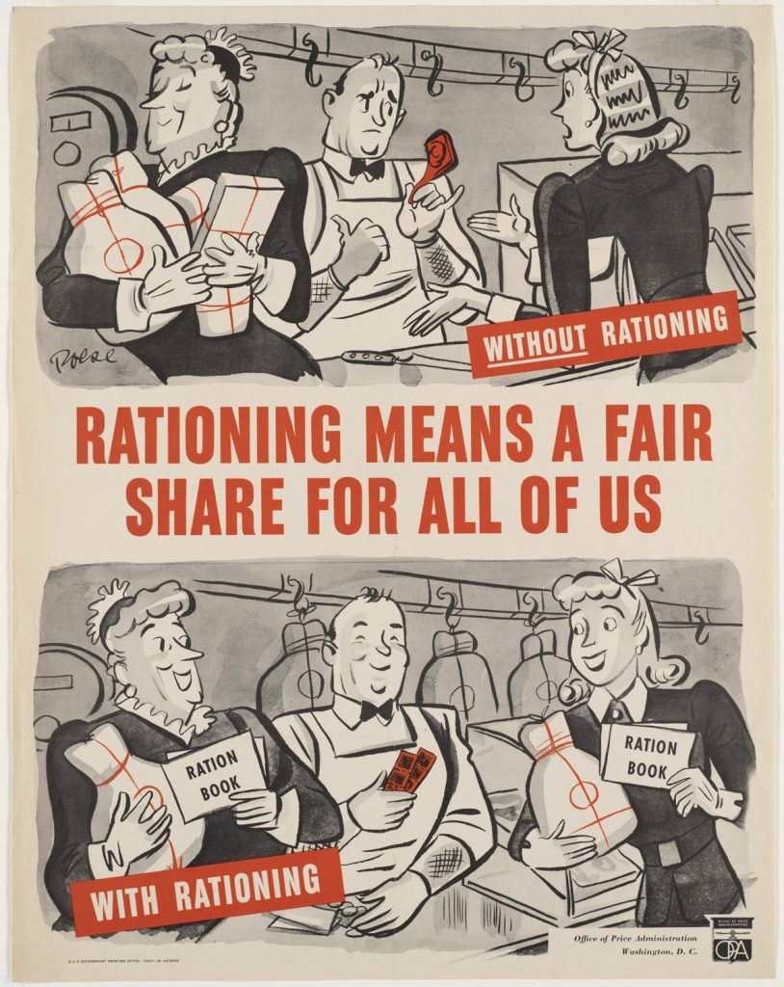
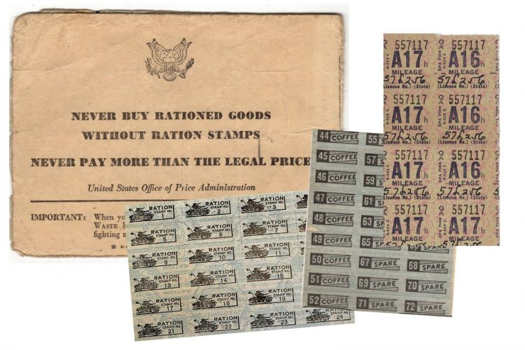
Why was rationing introduced?
Rationing was introduced because the men who usually worked on farms and in factories were away fighting in the war.
The food and fuel was needed for the military and the war effort.
Rationing meant a fair distribution of products.

Slide 13
Anne Frank
Anne Frank was a Dutch Jew. At the age of 13, Anne went into hiding with her family to escape from the Nazis. Hitler hated Jews and wanted to exterminate them. For 2 years she hid in an annex.

Slide 14
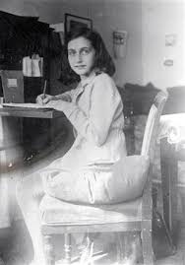
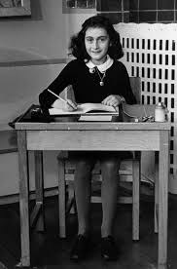
Anne Frank's Diary
For 2 years Anne couldn’t go outside or run or shout or laugh too loudly. Instead, she poured out thoughts and feelings into her diary, which is now famous all over the world. The story of her life begins when she was still a carefree girl. Anne and her sister died in Auschwitz in 1945.

Slide 15
My Granny and Grandad's Wartime Memories by Molly
My Granny was born during the war. She told me about the American soldiers walking through the fields of her farm in Rostrevor. They gave her family sweets, tights and an ointment for burns.
My Grandad recalls travelling to Omeath on a rowing boat from Narrow Water because there was no rationing in the Republic of Ireland. When his family saved enough money they could buy supplies that they needed. On one of those trips all his items were confiscated by a customs official and he never forgot it!

Slide 16
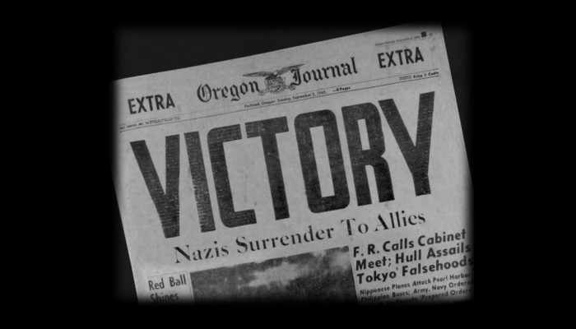
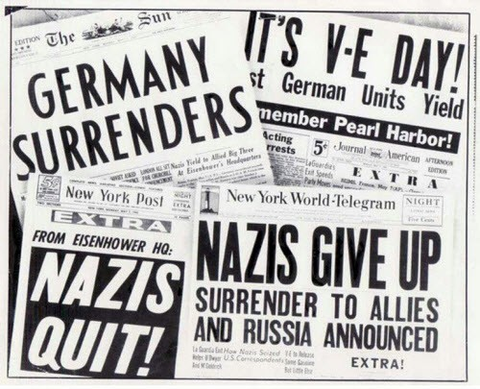
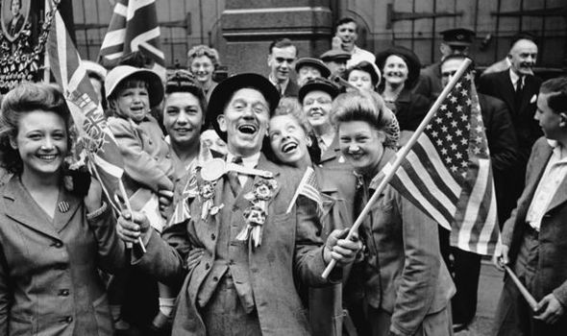
The end of the war
The Axis powers surrendered and Adolf Hitler committed suicide.

